Slide 1
Financial Sentiment Analysis
PROJECT P(226)
TEAM MEMBERS: Shama Patil
Shivaprasad P Goni
Rohit Raju Kamble
Prayag V K
Mentors Name : Ms. Neha Gupta
Mr. Hareesh

Slide 2

What is Sentiment Analysis ?
Sentiment analysis is the process of analyzing digital text to determine if the emotional tone of the message is positive, negative, or neutral.
Sentiment analysis is a technique through which you can analyze a piece of text to determine the sentiment behind it.
Sentiment analysis, also known as opinion mining, is an important business intelligence tool that helps companies improve their products and services.

Slide 3
Business Objective
Need to get sentiment analysis of financial statements and gauge its impact i.e. positive, negative or neutral on the business and government.
Provide objective insights : Businesses can avoid personal bias associated with human reviewers by using sentiment analysis tools. As a result, companies get consistent and objective results when analyzing customers’ opinions.
Real-time results : Businesses can rely on sentiment analysis software to learn what customers feel about the company's brand, products, and services in real time and take immediate actions based on their findings. They can configure the software to send alerts when negative sentiments are detected for specific keywords.

Slide 4
PROJECT ARCHITECTURE :
BUSINESS UNDERSTANDING
DATA TRANSFORMATION
& EDA
COLLECTION OF DATA
DEPLOYMENT
FINALIZING MODEL
MODEL SELECTION

Slide 5
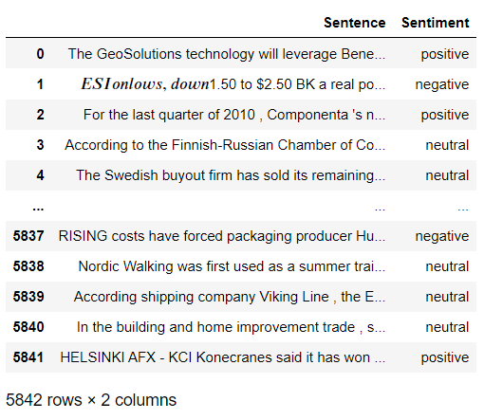
DataSet Details
The given dataset contains a total of 3 Classes(positive, negative and neutral), 2 features and 5842 rows.

Slide 6
Text Preprocessing and EDA
In natural language processing, text preprocessing is the practice of cleaning and preparing text data. NLTK and re are common Python libraries used to handle many text preprocessing tasks.
Removing all Unwanted Characters- \n \t, http links, tags, hashtags, html tags, converting to lower case, removing white spaces etc.
Word Tokenization - Tokenization is essentially splitting a phrase, sentence, paragraph, or an entire text document into smaller units, such as individual words or terms. Each of these smaller units are called tokens.
Removing Stop-words - A stop word is a commonly used word (such as “the”, “a”, “an”, “in”) that a search engine has been programmed to ignore, both when indexing entries for searching and when retrieving them as the result of a search query.
Lemmatization - Lemmatization is a text pre-processing technique used in natural language processing (NLP) models to break a word down to its root meaning to identify similarities. For example, a lemmatization algorithm would reduce the word better to its root word , good.

Slide 7
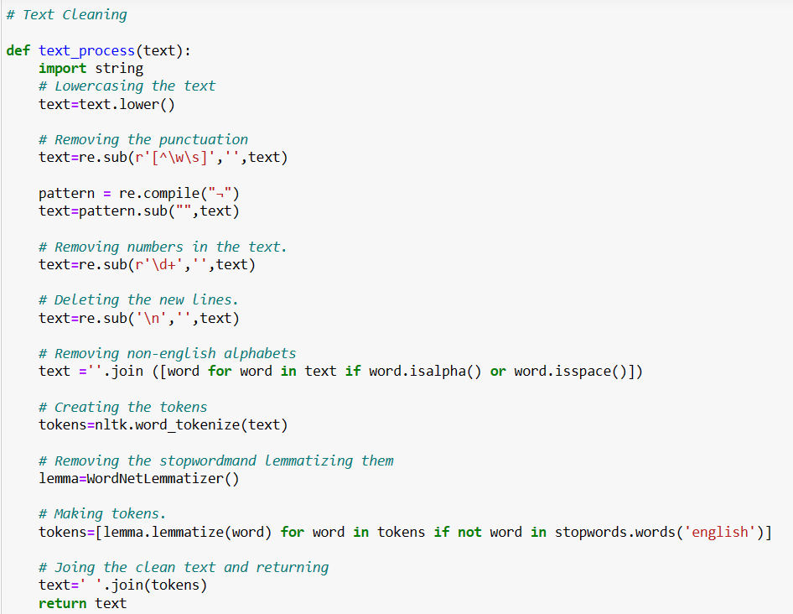

Slide 8
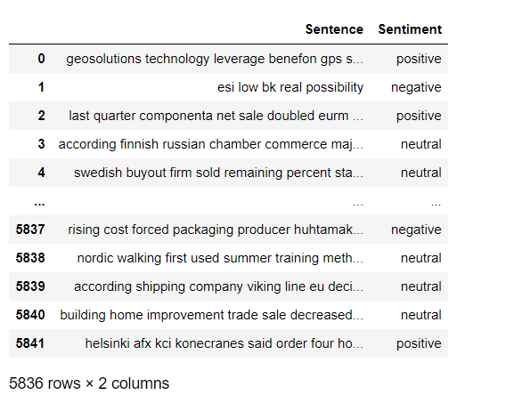
The Dataset now contains 5836 rows and 2 Column after text preprocessing.
There are total three Classes – positive, negative, neutral.

Slide 9
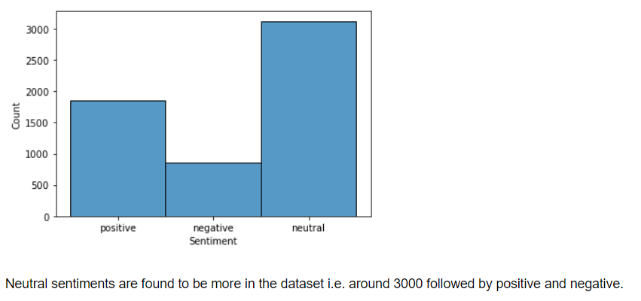
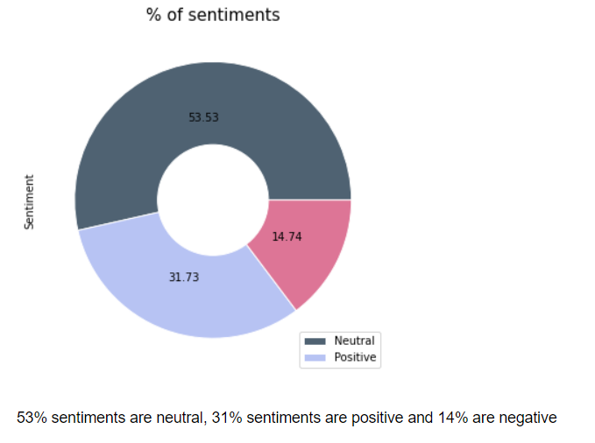
Visualization Of Dataset:
Bar plot for Sentiments Pie chart for % of Sentiments

Slide 10
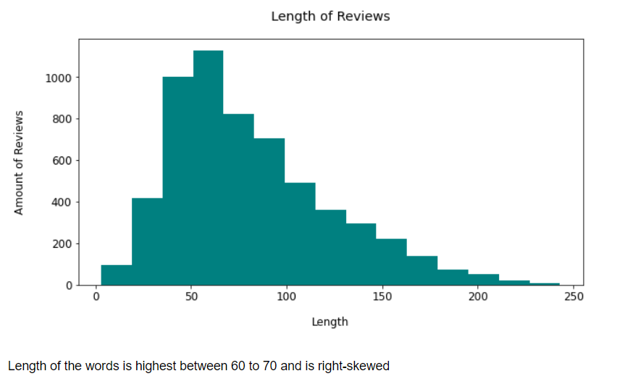
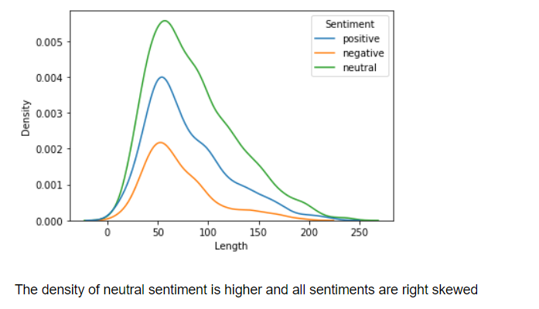
Density plot for length of words Histogram for length of sentences with
in each sentence respect to length of words

Slide 11
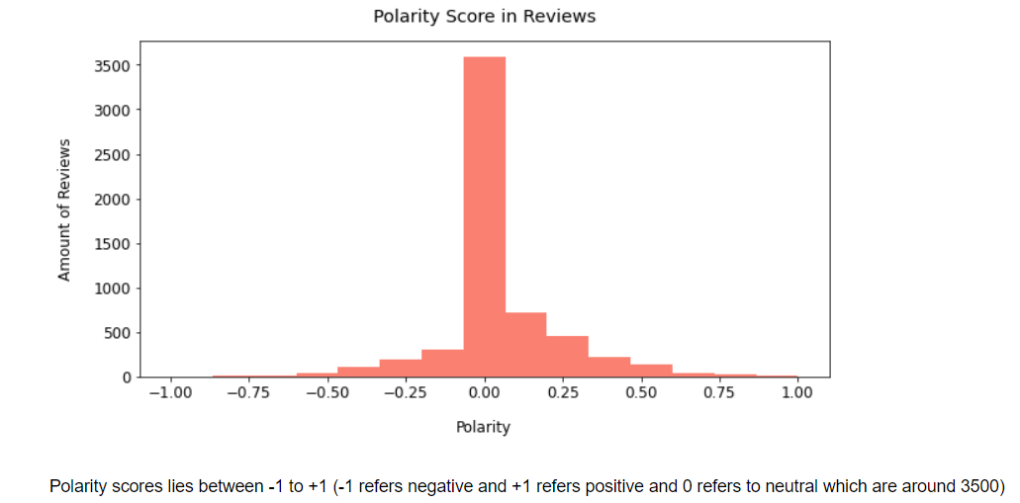
Polarity Score for Sentences

Slide 12
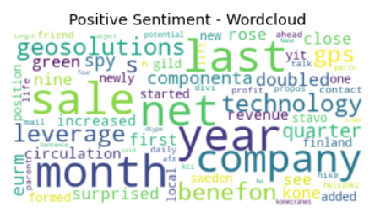
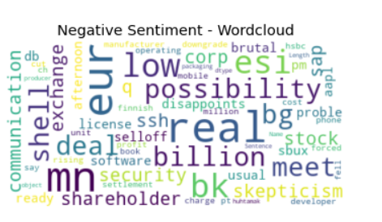
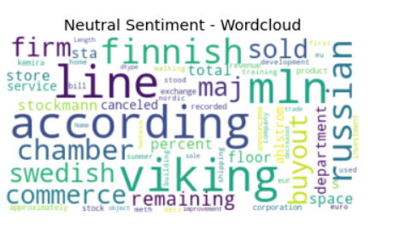
Wordcloud for positive, negative, neutral sentiments

Slide 13

Model Building

Slide 14
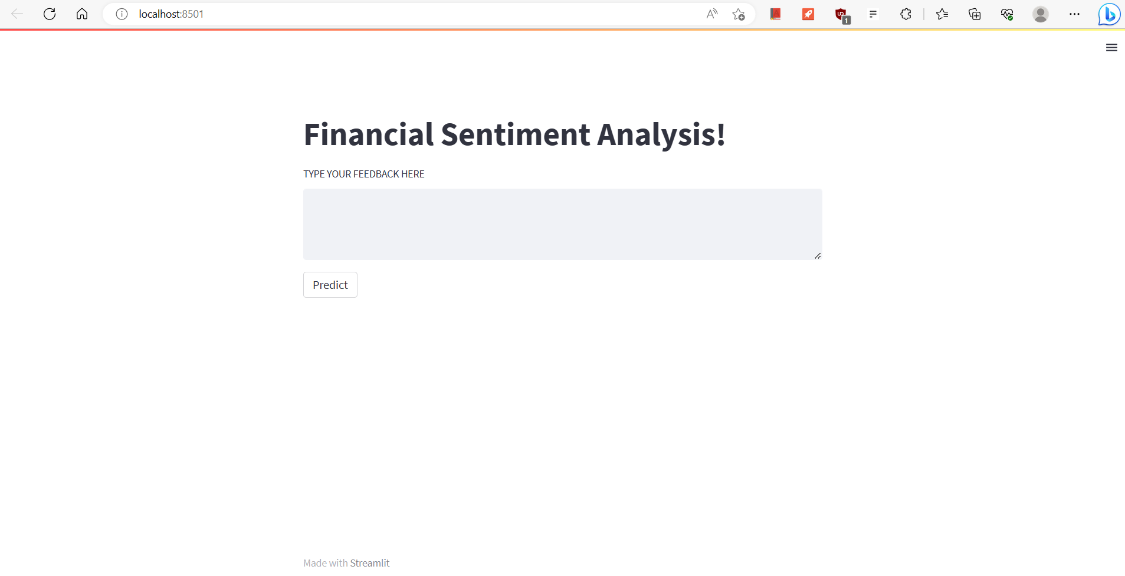
Deployment

Slide 15
THANK YOU

